Slide 1
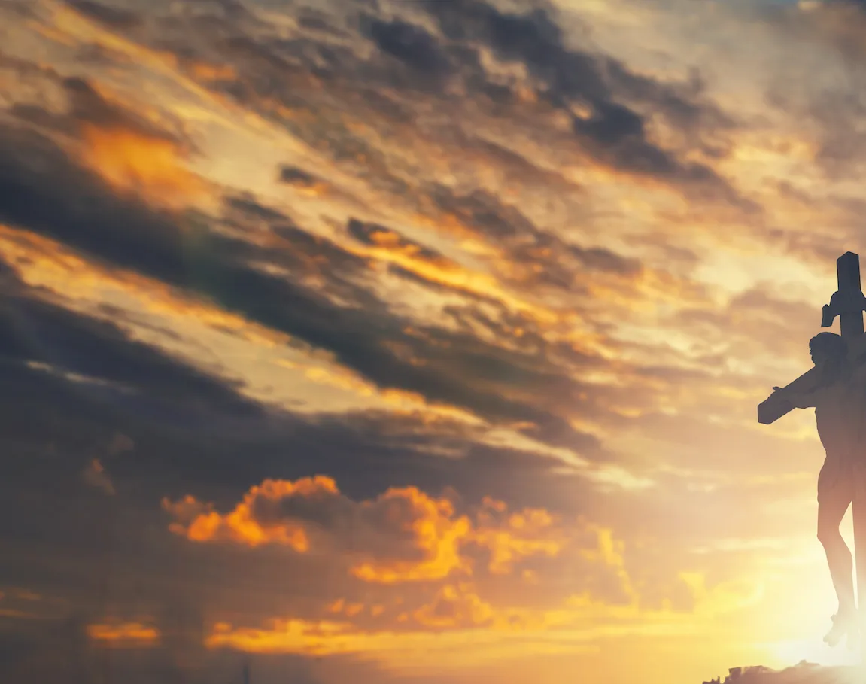
Your Grace is Enough

Slide 2
G C
Great is Your faithfulness oh God
Em D C
You wrestle with the sinner's heart
G C
You lead us by still waters and to mercy
Em D C
And nothing can keep us apart

Slide 3
Am G
So remember Your people
C D
Remember Your children
Am G C
Remember Your promise Oh God
to chorus

Slide 4
G D
Your grace is enough
Em C
Your grace is enough
G D C
Your grace is enough for me
to verse 2

Slide 5
G C
Great is Your love and justice God
Em D C
You use the weak to lead the strong
G C
You lead us in the song of Your salvation
Em D C
And all Your people sing along

Slide 6
Am G
So remember Your people
C D
Remember Your children
Am G C
Remember Your promise Oh God
to chrous

Slide 7
G D
Your grace is enough
Em C
Your grace is enough
G D C
Your grace is enough for me
x2 to pre chorus

Slide 8
Am G
So remember Your people
C D
Remember Your children
Am G C
Remember Your promise Oh God
to chorus

Slide 9
G D
Your grace is enough
Em C
Your grace is enough
G D C
Your grace is enough for me

Slide 10
G D
Your grace is enough
Em C
Heaven reaching down to us
G D C
Your grace is enough for me God I see
G D Em C
Your grace is enough I am covered in Your love
G D C
Your grace is enough for me…For me
END

Slide 11
Only A Holy God

Slide 12
Em / G / C / G
Em G C G
Who else commands all the hosts of heaven
Em G C G
Who else could make every king bow down
Em G C G
Who else can whisper and darkness trembles
C D G
Only a Holy God

Slide 13
Em G C G
What other beauty demands such praises
Em G C G
What other splendour outshines the sun
Em G C G
What other majesty rules with justice
C D G
Only a Holy God

Slide 14
Em C
Come and behold Him
G D
The One and the Only
Em C
Cry out, sing holy
G D Em
Forever a Holy God
C D G
Come and worship the Holy God

Slide 15
Em G C G
What other glory consumes like fire
Em G C G
What other power can raise the dead
Em G C G
What other name remains undefeated
C D G
Only a Holy God

Slide 16
Em C
Come and behold Him
G D
The One and the Only
Em C
Cry out, sing holy
G D Em
Forever a Holy God
C D G
Come and worship the Holy God
x2

Slide 17
Em G C G
Who else could rescue me from my failing
Em G C G
Who else would offer His only Son
Em G C G
Who else invites me to call Him Father
C D G
Only a Holy God

Slide 18
Em C
Come and behold Him
G D
The One and the Only
Em C
Cry out, sing holy
G D Em
Forever a Holy God
C D G
Come and worship the Holy God
END

Slide 19
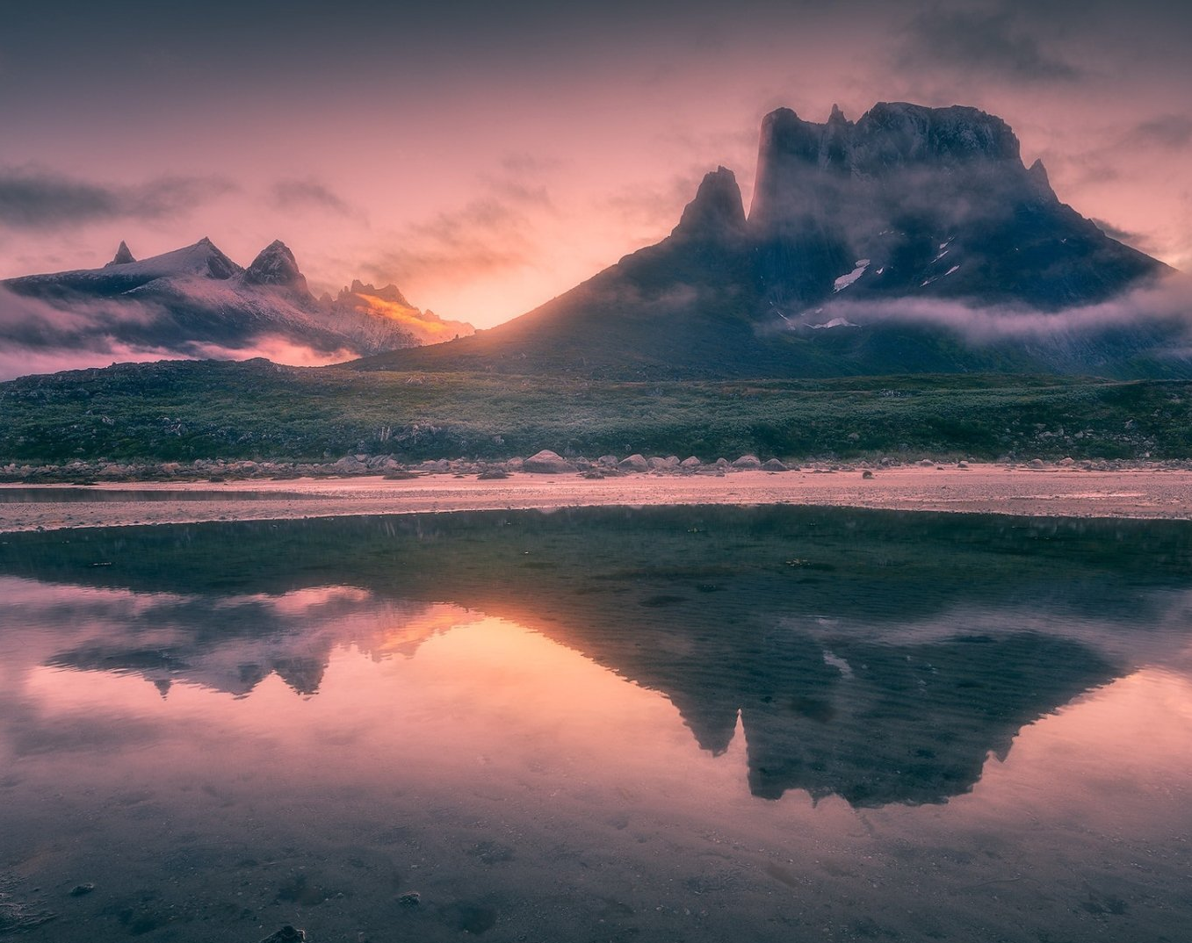
His Mercy is More

Slide 20
G C G Em D C G Em
Praise the Lord, His mercy is more
C D D Em
Stronger than darkness, new every morn
C G D G
Our sins they are many, His mercy is more

Slide 21
G
What love could remember,
C G
no wrongs we have done
D Em
Omniscient all-knowing,
C D
He counts not their sum

Slide 22
G Am
Thrown into a sea,
G C
without bottom or shore
C G
Our sins they are many,
D G
His mercy is more

Slide 23
G C G Em D C G Em
Praise the Lord, His mercy is more
C D D Em
Stronger than darkness, new every morn
C G D G
Our sins they are many, His mercy is more

Slide 24
G C G
What patience would wait as we constantly roam
D Em C D
What Father so tender is calling us home
G Am G C
He welcomes the weakest, the vilest, the poor
C G D G
Our sins they are many, His mercy is more

Slide 25
G C G Em D C G Em
Praise the Lord, His mercy is more
C D D Em
Stronger than darkness, new every morn
C G D G
Our sins they are many, His mercy is more

Slide 26
G C G
What riches of kindness He lavished on us
D Em C D
His blood was the payment, His life was the cost
G Am G C
We stood 'neath a debt we could never afford
C G D G
Our sins they are many, His mercy is more

Slide 27
G C G Em D C G Em
Praise the Lord, His mercy is more
C D D Em
Stronger than darkness, new every morn
C G D G
Our sins they are many, His mercy is more
REPEAT & END

Slide 28
Here I am to Worship

Slide 29
G D Am
Light of the world You stepped down into darkness
G D C
Opened my eyes, let me see
G D Am
Beauty that made this heart adore You
G D C
Hope of a life spent with You

Slide 30
G D
Here I am to worship Here I am to bow down
G C
Here I am to say that You're my God
G D
You're altogether lovely Altogether worthy
G C
Altogether wonderful to me

Slide 31
G D Am
King of all days, oh so highly exalted
G D C
Glorious in heaven above
G D Am
Humbly You came to the earth You created
G D C
All for love's sake became poor

Slide 32
G D
Here I am to worship Here I am to bow down
G C
Here I am to say that You're my God
G D
You're altogether lovely Altogether worthy
G C
Altogether wonderful to me
x2 to Bridge

Slide 33
D G C
I'll never know how much it cost
D G C
To see my sin upon that cross
x3 to Chorus

Slide 34
G D
Here I am to worship Here I am to bow down
G C
Here I am to say that You're my God
G D
You're altogether lovely Altogether worthy
G C
Altogether wonderful to me
x2 to End

Slide 35
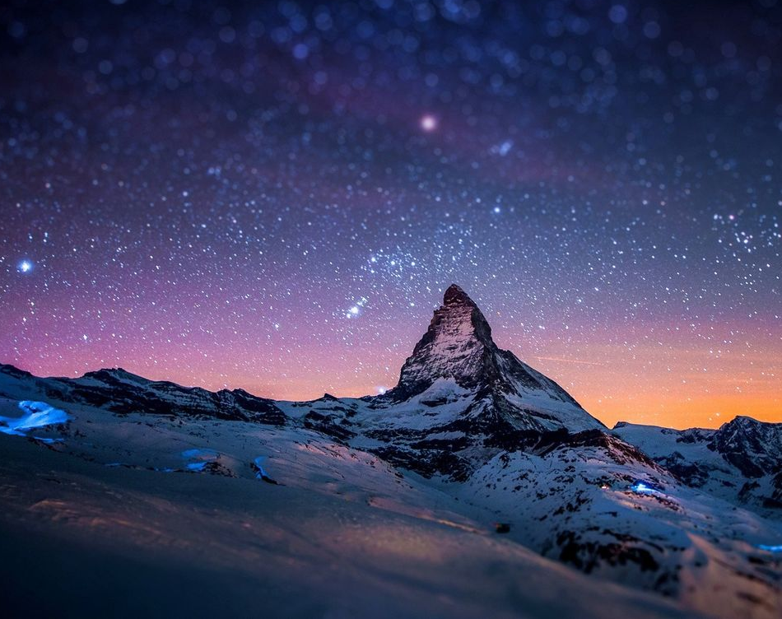
It Is Well

Slide 36
G C D G
When peace like a river attendeth my way
Em A D
When sorrows like sea billows roll
G C A D
Whatever my lot, Thou hast taught me to say
G C D G
It is well, it is well with my soul

Slide 37
G D
It is well (it is well)
D G
With my soul (with my soul)
C G D G
It is well, it is well with my soul

Slide 38
G C D G
Though Satan should buffet, though trials should come
Em A D
Let this blest assurance control
G C A D
That Christ has regarded my helpless estate
G C D G
And has shed His own blood for my soul

Slide 39
G D
It is well (it is well)
D G
With my soul (with my soul)
C G D G
It is well, it is well with my soul

Slide 40
G C D G
My sin - O, the bliss of this glorious thought
Em A D
My sin - not in part but the whole
G C A D
Is nailed to the cross and I bear it no more
G C D G
Praise the Lord, praise the Lord, O my soul

Slide 41
G D
It is well (it is well)
D G
With my soul (with my soul)
C G D G
It is well, it is well with my soul

Slide 42
G C D G
And, Lord haste the day when the faith shall be sight
Em A D
The clouds be rolled back as a scroll
G C A D
The trump shall resound and the Lord shall descend
G C D G
Even so - it is well with my soul

Slide 43
G D
It is well (it is well)
D G
With my soul (with my soul)
C G D G
It is well, it is well with my soul

